Slide 1


Doris Afriyie Amoakohene Msc, Informatics
Benchmarking Performance in the data.table Package

Slide 2
Outline of Presentation
Introduction
Understanding Performance Regressions in data.table
Introduction to the atime package for performance analysis
Creating Relevant Performance Tests
Analyzing Code Branches using atime
Comparing data.table with Python Packages
Enhancing data.table: Educational Resources
Conclusion

Slide 3
Introduction

Slide 4
Objectives of the presentation
Examine data.table repository, including issues about performance regressions, to create five new relevant performance tests, and use atime to analyze three different code branches (before regression, regression, fix regression) and create github action for performance testing, which is run for every Pull request.
Utilize the atime package to generate figures that demonstrate the efficiency of the data.table package in comparison to other Python packages such as pandas.
Improve data.table to make two educational resources like blog posts or videos to teach users how to use data.table effectively.

Slide 5





Overview of the data.table repository
data.table is an extension of R’s data.frame, designed to handle large datasets efficiently. It provides a syntax that is both concise and expressive, allowing users to perform complex data manipulations with ease. Its efficiency is particularly evident when dealing with tasks like filtering, grouping, aggregating, and joining data.
The development team behind data.table is committed to continuously improving its performance.
several major version changes have been introduced, aiming to enhance speed and efficiency.
These changes include algorithmic optimizations, memory management improvements, and enhancements to parallel processing capabilities.
Upgrading to the latest version ensures that users can leverage the most recent performance enhancements.

Slide 6
Importance of performance testing and analysis
It is important that we prevent significant performance regression from reaching the data.table package.
Here are some of the main reasons why performance testing is conducted:
Ensure Efficiency
Ensure User Satisfaction
Detect Performance Issues
Optimize Resource Utilization
Mitigate Risks

Slide 7
Understanding Performance Regressions in data.table

Slide 8
Introduction to the atime package for performance analysis
To evaluate data.table performance, it is essential to employ benchmarking methodologies.
The approach I used utilizes the atime_versions function from the atime package, which measures the actual execution time of specific operations. This function allows for accurate comparisons between different versions of the data.table package, by benchmarking against time and memory usage and giving a graphical visualization of the results.
Running performance tests on commits helps maintain a high-performance standard for the package, detect and fix performance regressions, optimize code, validate performance improvements, ensure consistent.

Slide 9
When using atime_versions, there are six main arguments:
When using atime_versions, there are six main arguments:
pkg.path: This argument specifies the location on your system where you have stored a git clone of the data.table package.
pkg.edit.fun: The default behavior of pkg.edit.fun is designed to work with Rcpp packages and involves replacing instances of “PKG” with “PKG.SHA” in the package code. Any occurrences of the string “PKG” within the package code will be replaced with “PKG.SHA”, where “SHA” represents the commit SHA/ids associated with the version being installed.
N: This argument determines the number of iterations for the benchmarking process. It is a sequence of numbers that define different data sizes to test the performance of the operation.
setup: This section contains the setup code for generating the dataset used in the benchmarking process, the setup is determined by the value of N.
expr: This section contains the expression that represents the operation being benchmarked. It uses the data.table::[.data.table“ syntax to perform the operation on the dataset.
... : This section specifies the different versions of the data.table packages that will be tested. It includes three versions: “Before,” “Regression,” and “Fixed.” Each version is associated with a specific commit id.

Slide 10
Example of code
atime::atime_versions(
pkg.path=tdir,
pkg.edit.fun= pkg.edit.fun,
N=10ˆseq(1,20),
setup={ set.seed(108) d <- data.table( id3 = sample(c(seq.int(N*0.9), sample(N*0.9, N*0.1, TRUE))),
v1 = sample(5L, N, TRUE), v2 = sample(5L, N, TRUE))
},
expr=data.table:::`[.data.table`(d, , (max(v1)-min(v2)), by = id3),
"Before"="15f0598b9828d3af2eb8ddc9b38e0356f42afe4f",
"Regression"="6f360be0b2a6cf425f6df751ca9a99ec5d35ed93",
"Fixed"="ba32f3cba38ec270587e395f6e6c26a80be36be6“

Slide 11
Creating Relevant Performance Tests

Slide 12
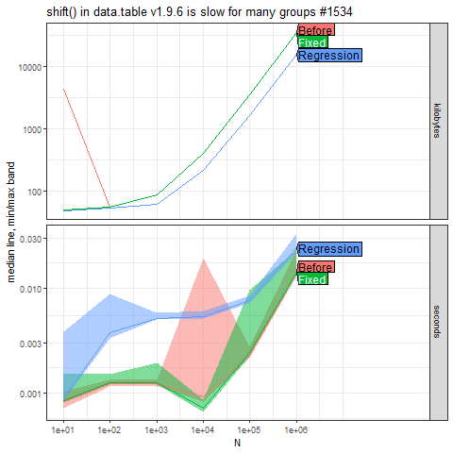
Issue 1
A. The user mentions that the shift() function in data.table version 1.9.6 is slow when applied to many groups.
B. The exact cause or specific use case is not elaborated upon in the issue.
C. The pull request address the issue by allowing GForce optimization for lapply even without using .SD1.

Slide 13
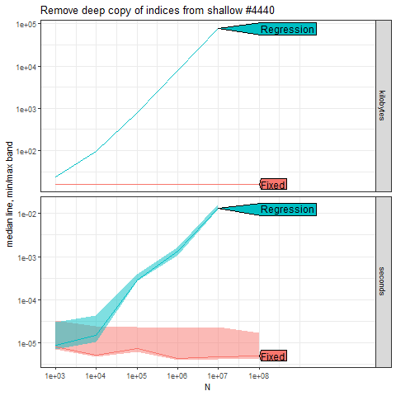
Issue 2
A. This issue reported that when using the dt[selector, foo := bar] syntax with an index defined, the performance of that operation can be significantly slower compared to when there is no index.
B. The regression was caused by utilizing the ":=" operator with an index present while modifying data by reference.
C. Fixes Regression by passing shallow(dt.s4) to the isS4() function.

Slide 14
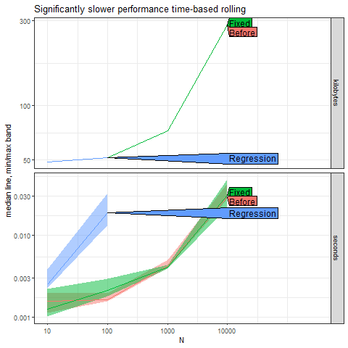
xxx
Issue 3

Slide 15
Issue 4

Slide 16
Comparing data.table with Python Packages (pandas)

Slide 17
atime function for comparative benchmarking
We will use atime package to compare and visualize the asymptotic performance (time and memory usage) of the different functions .
In the atime::atime() we define the following arguments,
By comparing the asymptotic performance of these packages in these programming languages, we aim to provide insights into their usage and help data scientists make informed choices when it comes to data manipulation and analysis.
The first argument N is a sequence of data sizes. This explores computational efficiency, which will compute time/memory usage for different data sizes(N).
The second argument setup is an expression that will be evaluated for each value in N, to create data of a given size.
seconds.limit may optionally be specified. If an expression is slower than this limit for any data size, then a larger data sizes will be measured.
Lastly, expr.list, which is the list of expressions for which time/memory usage will be measured.

Slide 18
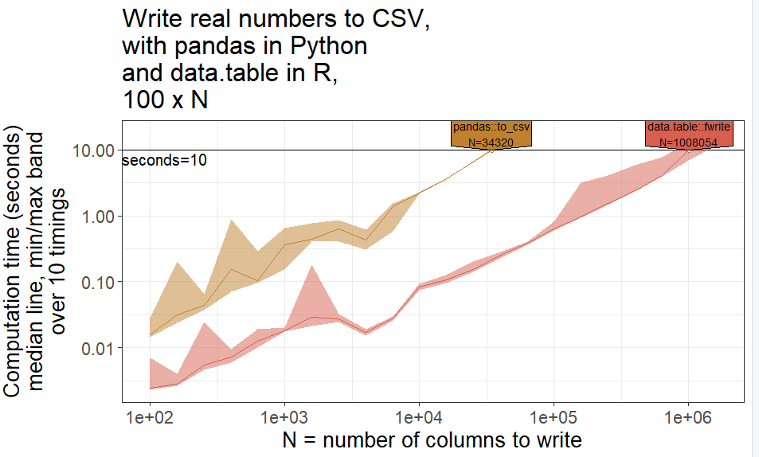
Writing CSV

Slide 19
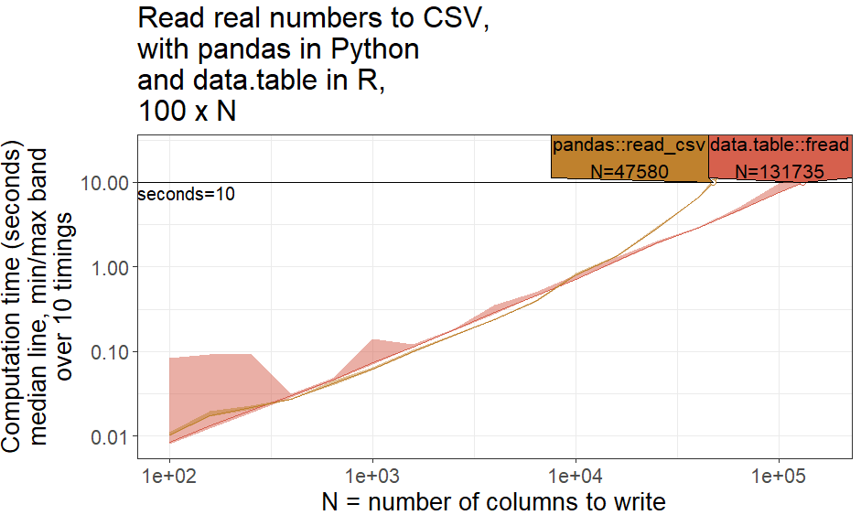
Reading CSV

Slide 20
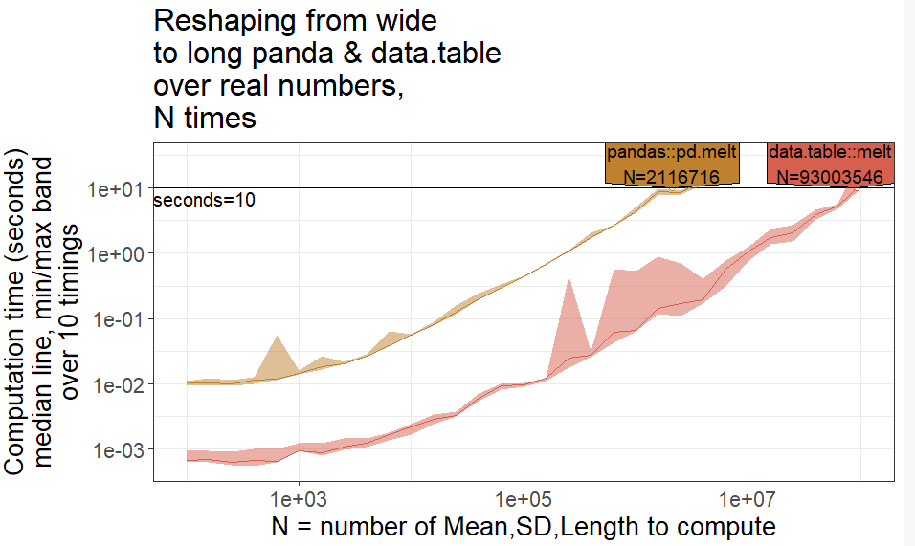
Wide to long pandas::pd.melt & data.table::melt

Slide 21
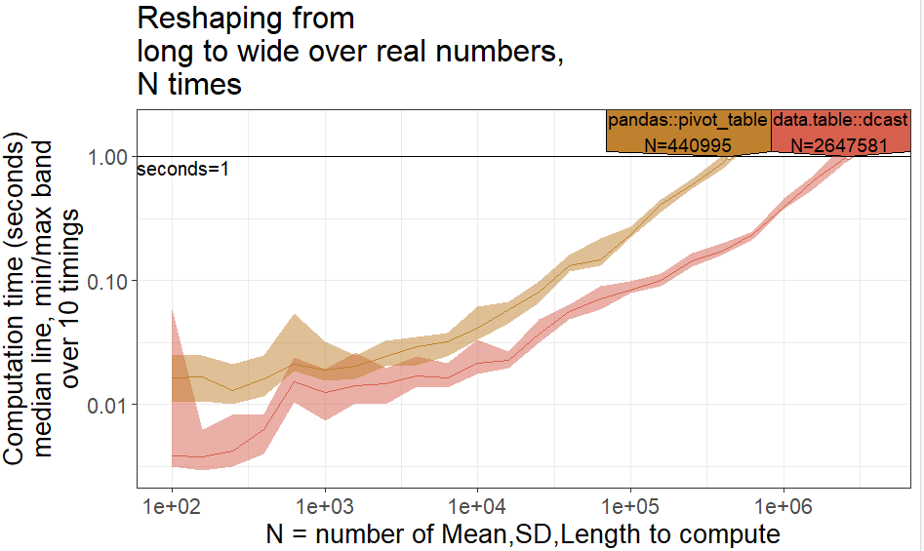
Long to wide pandas::pivot_table& data.table::dcast

Slide 22
Enhancing data.table with Educational Resources

Slide 23




Visualizing Performance Regression of data.table with Atime
Performance Comparison: Data.table in R and Pandas in Python
I have provided the links to these blogs on my GitHub (DorisAmoakohene)

Slide 24
THANK YOU!! END OF SLIDES

